Slide 1
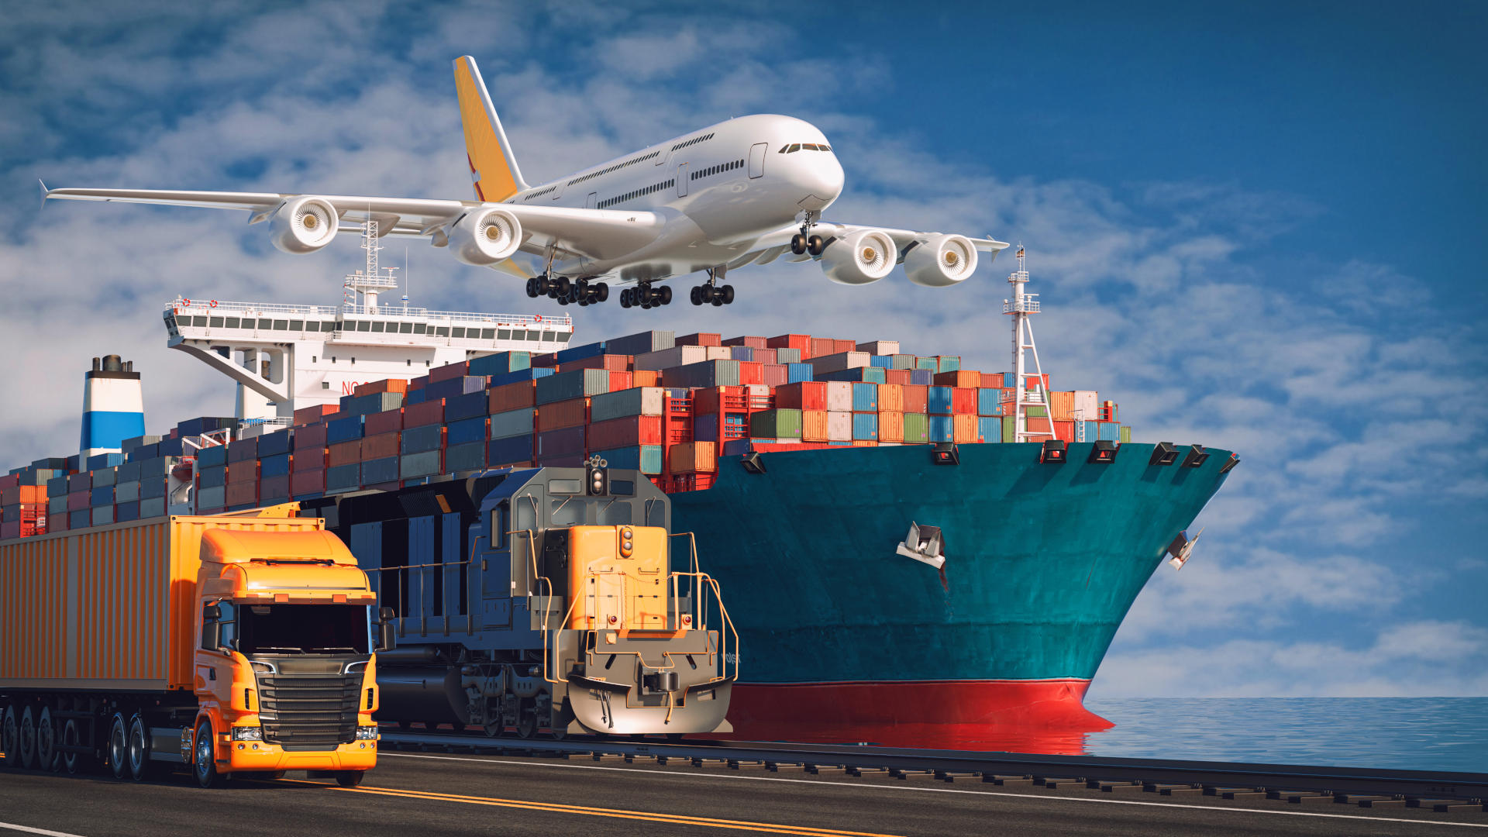


TRANSBORDER FREIGHT DATA ANALYSIS
by Solomon Sannie

Slide 2
Slide 2
Introduction
Methodology
Key Research Questions
Hypothesis
Visualizations
Conclusion
Recommendation
OUTLINE
2

Slide 3
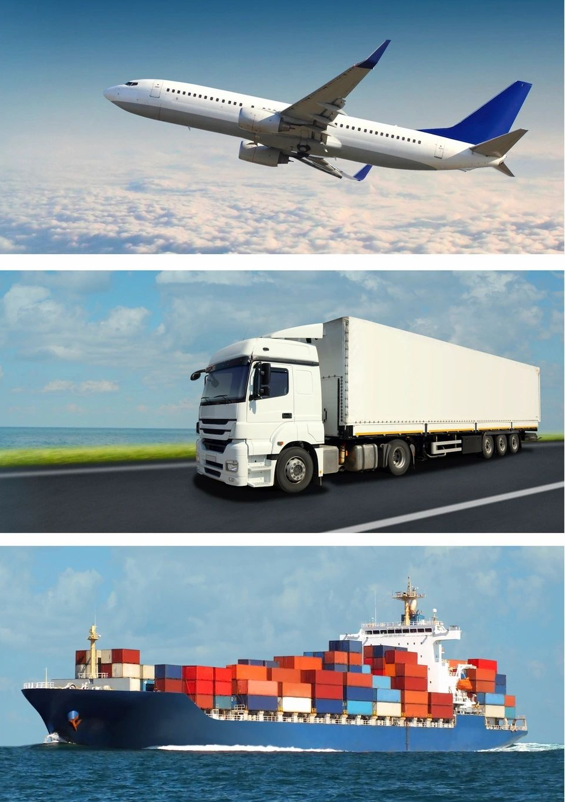
Slide 3
INTRODUCTION
Transborder freight transport defines the movement of goods across national borders. It is vital to economic exchange and trade efficiency.
This analysis explores freight patterns between major trade partners, particularly Canada, the United States, and Mexico. Using monthly freight data categorized by transportation mode and commodity type, the study aims to uncover key trends, challenges, and actionable insights.

Slide 4
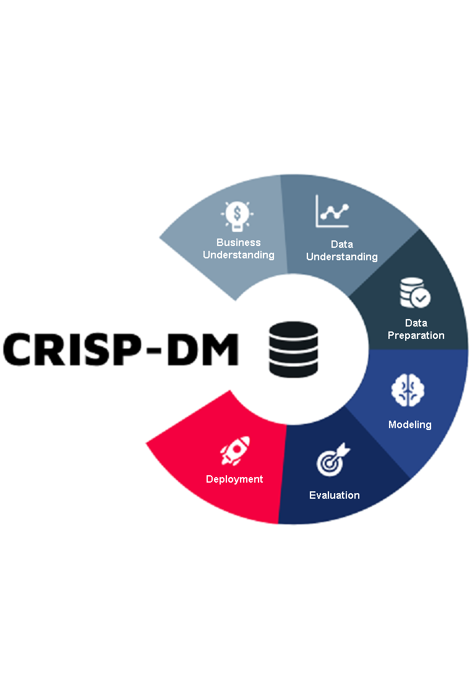
Slide 3
METHODOLOGY
Business Understanding: Defined project goals, identify trends, inefficiencies, and opportunities in transborder freight movement.
Data Understanding: Explored monthly BTS datasets covering multiple transport modes and commodity flows.
Data Preparation: Cleaned, formatted, and integrated datasets. Addressed missing values and standardized location codes.
Modeling: Used descriptive models and clustering techniques to uncover freight patterns.
Evaluation: Assessed visualizations and findings against key research questions and hypotheses.
Deployment: Packaged insights into visual dashboards and presentation for stakeholder decision-making.

Slide 5
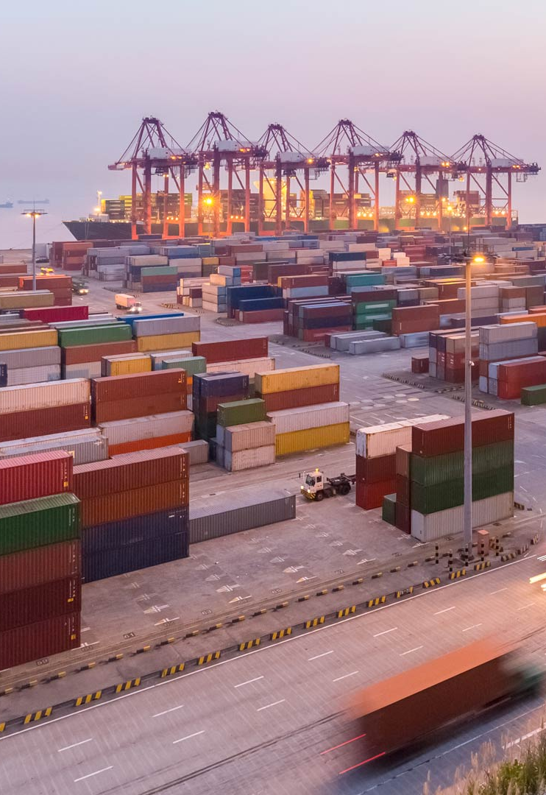
Slide 3
KEY RESEARCH QUESTIONS
Freight Movement Patterns
1
How is freight moving across different transportation modes over time and regions?
Trade Value Trends
2
How has the total trade value evolved from 2020 to 2024?
Environmental Impact
3
Which modes or routes are least environmentally friendly?
Economic Contributions
4
How much does each mode contribute to economic productivity across regions (e.g., by border state)?
3

Slide 6
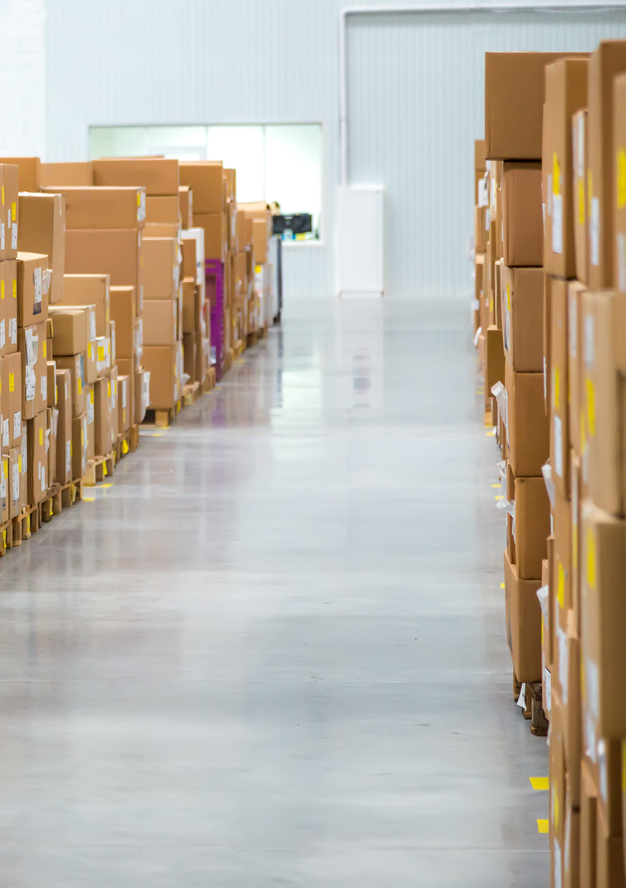
Slide 3
HYPOTHESIS
Primary Hypothesis: Trucking is the most dominant mode of transborder freight transport due to flexibility and reach, but it significantly contributes to environmental impact and border congestion.
Supporting Hypotheses:
Rail and pipeline freight offer greater sustainability and efficiency, yet remain underutilized.
Seasonal peaks particularly in Q2 and Q3 intensify freight activity, stressing infrastructure and causing delivery delays.
States with major ports or border crossings (e.g., Texas, California, Michigan) experience higher freight traffic and cost variability.
Import freight tends to be more concentrated and predictable than export freight, which shows higher variability across modes and destinations.
3

Slide 7
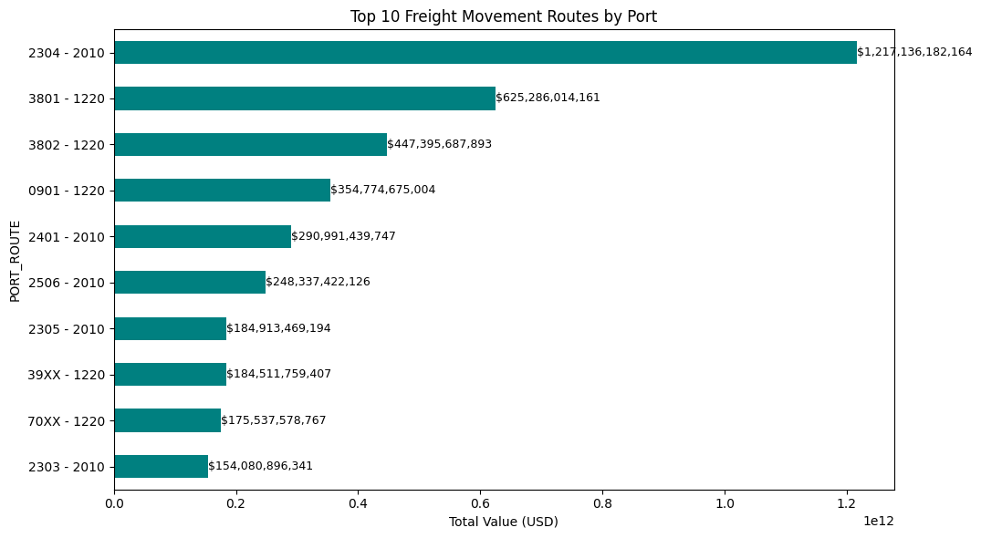
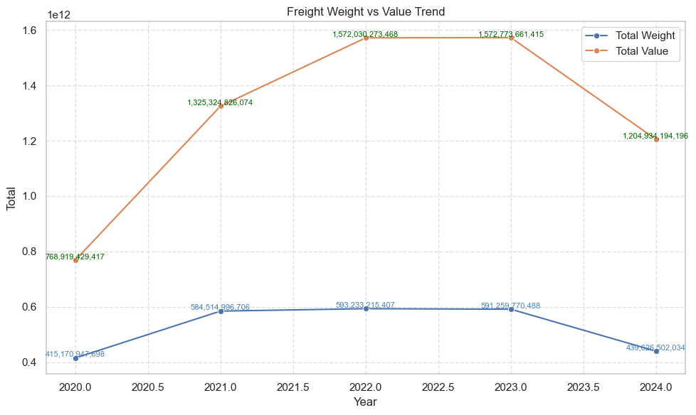
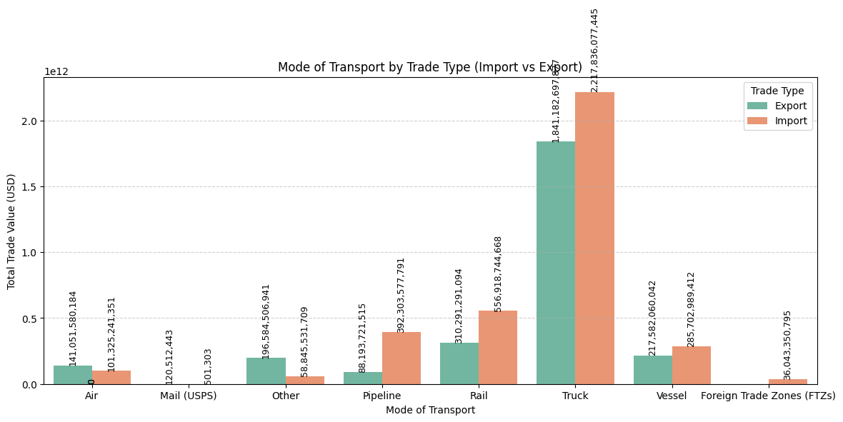
Slide 3
VISUALIZATION
3

Slide 8
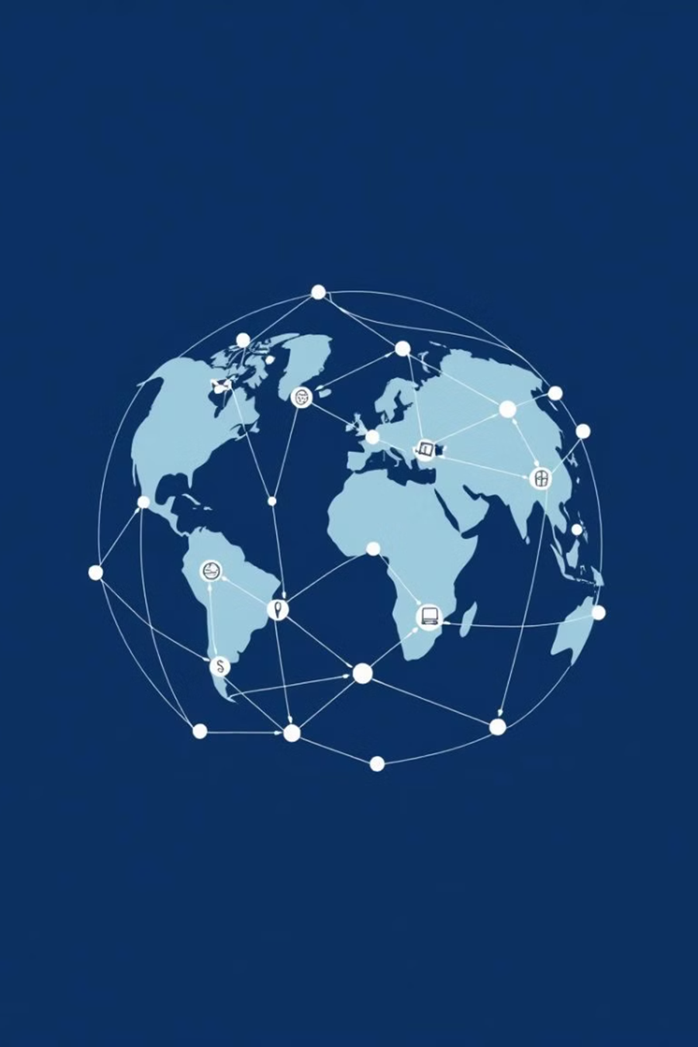
Slide 3
CONCLUSION
Road transport continues to dominate transborder freight movement due to its flexibility but it also remains the primary contributor to congestion and environmental emissions. Key logistical states such as, Texas, Michigan, and California play a central role in freight activity, necessitating ongoing investments in infrastructure and transportation systems. To mitigate environmental impact and improve freight resilience, greater emphasis should be placed on expanding the use of rail and water transport.
1
Road Transport
Dominant, but causes environmental emissions.
2
Key Freight Hubs
TX, MI, CA need investment in infrastructure.
3
Import Charges
Need supply chain optimization.

Slide 9
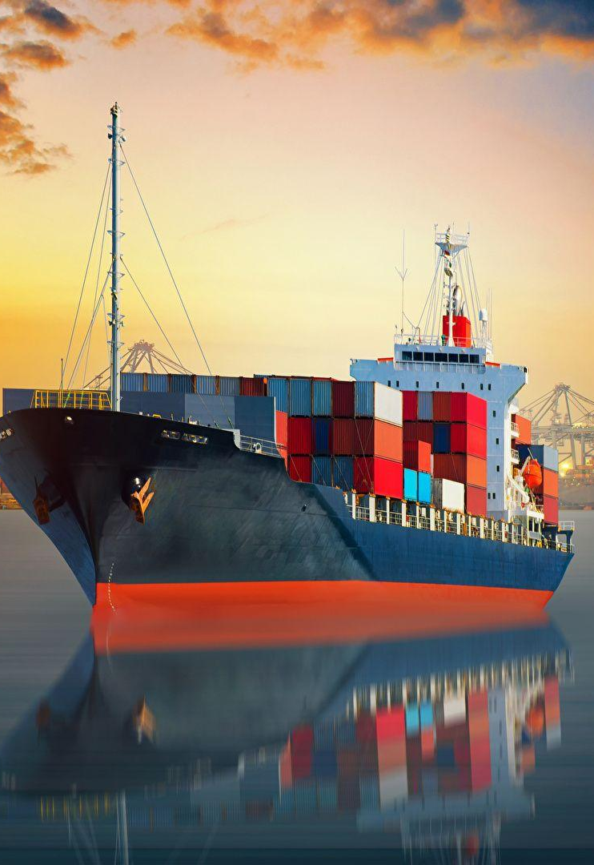
Slide 3
RECOMMENDATIONS
To enhance the efficiency and sustainability of transborder freight movement, a strategic shift in transportation planning is essential. Greater investment should be directed toward rail and waterway infrastructure to reduce the overreliance on road transport and mitigate environmental impacts. Key logistics hubs such as Texas, Michigan, and California require targeted upgrades to improve throughput and accommodate seasonal surges. Additionally, adopting data-driven forecasting models will enable adaptive freight management during peak periods, while supporting the transition to cleaner, fuel-efficient transport alternatives.
Invest in Rail / Water Transport
Expand intermodal hubs
Optimize Exports
Use trade agreements to lower tariffs
Enhance Infrastructure
Increase warehouse capacity

Slide 10
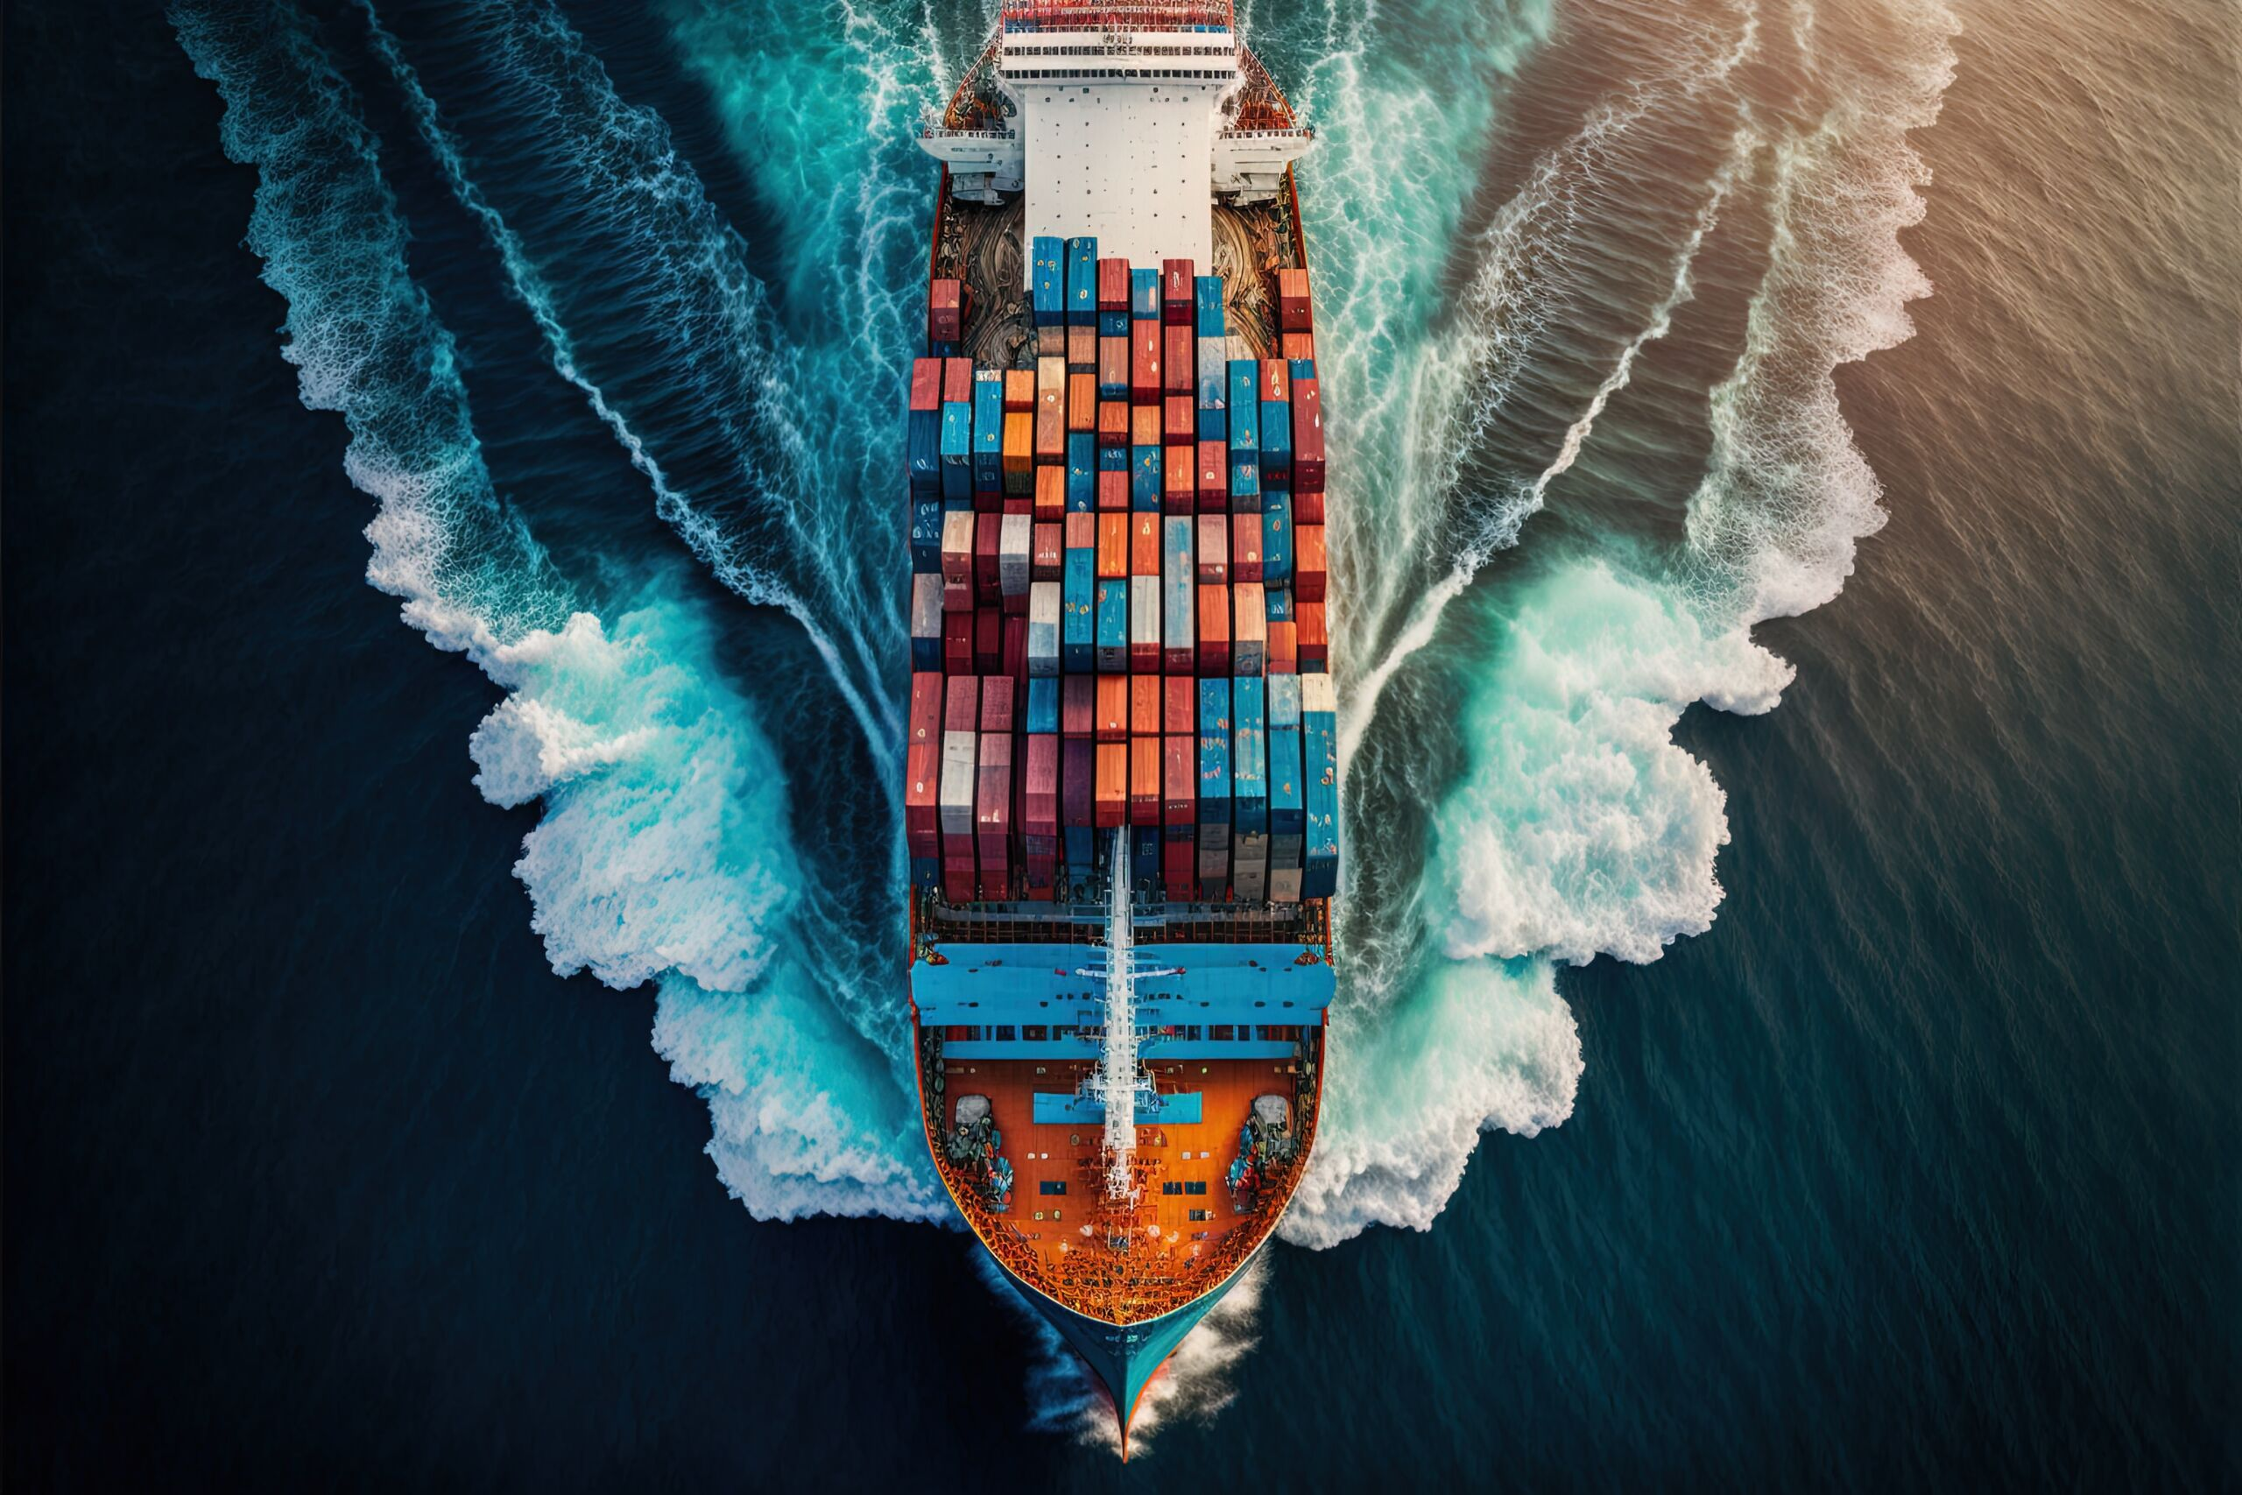

Slide 11
THANK YOU

